Slide 1

Circuit Switching
v/s
Packet Switching

Slide 2

Circuit Switching
Circuit Switching establishes a dedicated path between sender and receiver before communication, using the full network bandwidth. Data flows without delay, and bit delay remains constant. While it guarantees a fixed data rate, it is costly and inefficient for high-traffic or large networks due to reserved resources.
  Bandwidth is divided into pieces.
  Bit delay is constant during communication.
  Data can flow without delay once the circuit is established.

Slide 3
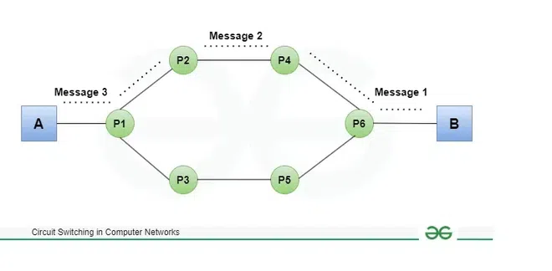
Circuit Switching

Slide 4
Circuit Switching
The telephone system network is one of the examples of Circuit switching. Two methods of multiplexing multiple signals into a single carrier are:
  FDM (Frequency Division Multiplexing)
  TDM (Time Division Multiplexing)

Slide 5
Circuit Switching
Frequency Division Multiplexing
  Divides total bandwidth into non-overlapping frequency bands.
  Each band carries a separate signal simultaneously.
  Used in radio, TV, and optical fibre for multiple independent signals.

Slide 6
Circuit Switching
Frequency Division Multiplexing
  Divides total bandwidth into non-overlapping frequency bands.
  Each band carries a separate signal simultaneously.
  Used in radio, TV, and optical fibre for multiple independent signals.

Slide 7
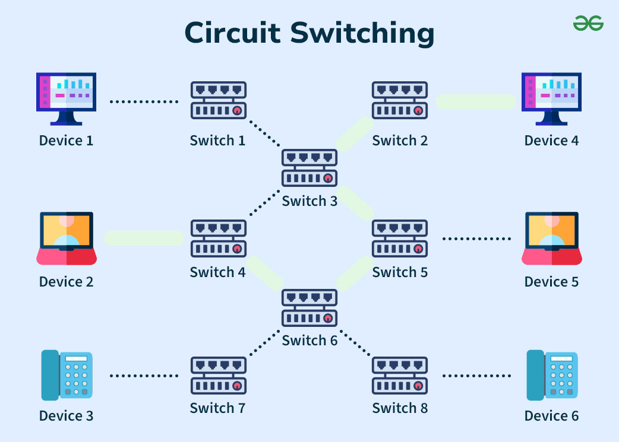
Circuit Switching
Frequency Division Multiplexing

Slide 8
Circuit Switching
Time Division Multiplexing
  Transmits multiple signals over the same channel at different time slots.
  Uses synchronized switches at both ends.
  Suitable for long-distance links with heavy data traffic.
  Also called a digital circuit switch

Slide 9
Circuit Switching
Time Division Multiplexing
  Continuous connections: Circuit switching is used for connections that must be maintained for long periods, such as long-distance communication. Circuit switching technology is used in traditional telephone systems.
  Dial-up network connections: When a computer connects to the internet through a dial-up service, it uses the public switched network. Dial-up transmits Internet Protocol (IP) data packets via a circuit-switched telephone network.
  Optical circuit switching: Data centre networks also make use of circuit switching. Optical circuit switching is used to expand traditional data centres and fulfil increasing bandwidth demands.

Slide 10
Circuit Switching
Advantages
  Guaranteed data rate: Dedicated channel ensures consistent transmission speed.
  No delay in data flow: Dedicated path allows continuous data transfer.
  High reliability: Reserved path prevents data loss or corruption.
  Quality of service (QoS): Supports prioritization of critical traffic like voice or video.

Slide 11
Circuit Switching
Disadvantages
  Limited scalability: Not suitable for large networks; needs a dedicated path for each communication.
  Vulnerable to failures: If a path fails, communication is disrupted.
  Limited flexibility: Dedicated circuits cannot be used by others until communication ends.
  Wastes resources: Bandwidth is reserved even when no data is sent.
  High cost: Setting up and maintaining dedicated paths is expensive.

Slide 12
Packet Switching
The packet switching information is transferred in the form of a data packets between the sender and the receiver. These packets are forwarded one by one from a sender to a receiver. Each packet is associated with a Header. Then, these packets then reassembled into the original message. This improves the performance as the time require to access the data packet is reduced. Due to this, the overall performance of the network is improved.

Slide 13
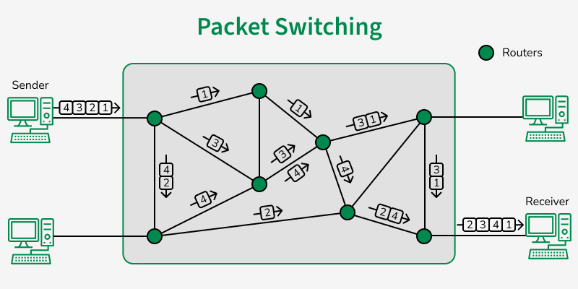
Packet Switching

Slide 14
Packet Switching
Advantages
  Efficient use of network resources as multiple users can share the same communication lines simultaneously. This leads to better utilization of available bandwidth and reduced costs.
  Improved reliability through dynamic routing, allowing data to find alternative paths if one route is congested or fails. This enhances network resilience and ensures data delivery even in partial network failures.
  Flexibility in handling various types of data and traffic patterns. Packet switching can easily accommodate different data types and varying loads, making it adaptable to diverse network requirements.

Slide 15
Packet Switching
Disadvantages
  Potential for packet loss or out-of-order delivery, requiring additional protocols for error checking and sequencing. This can lead to increased complexity in network management and potential data integrity issues.
  Variable latency due to different routing paths and network conditions, which can affect real-time applications. This unpredictability can be problematic for time-sensitive services like voice or video communications.
  Overhead from packet headers and routing information, reducing the effective data transmission rate. Each packet carries extra information for routing and reassembly, which consumes some of the available bandwidth.

Slide 16
Circuit Switching v\s Packet Switching
Circuit Switching | Packet Switching
Circuit switching has 3 phases: i) Connection Establishment. ii) Data Transfer. iii) Connection Released. | In Packet switching directly data transfer takes place.
In circuit switching, each data unit knows the entire path address which is provided by the source. | In Packet switching, each data unit just knows the final destination address intermediate path is decided by the routers.
In Circuit switching, data is processed at the source system only | In Packet switching, data is processed at all intermediate nodes including the source system.

Slide 17
Circuit Switching v\s Packet Switching
Circuit Switching | Packet Switching
The delay between data units in circuit switching is uniform. | The delay between data units in packet switching is not uniform.
Resource reservation is the feature of circuit switching because the path is fixed for data transmission. | There is no resource reservation because bandwidth is shared among users.
Circuit switching is more reliable. | Packet switching is less reliable.
Wastage of resources is more in Circuit Switching | Less wastage of resources as compared to Circuit Switching
It is not a store and forward technique. | It is a store and forward technique.

Slide 18
Circuit Switching v\s Packet Switching
Circuit Switching | Packet Switching
Transmission of the data is done by the source. | Transmission of the data is done not only by the source but also by the intermediate routers.
Congestion can occur during the connection establishment phase because there might be a case where a request is being made for a channel but the channel is already occupied. | Congestion can occur during the data transfer phase, a large number of packets comes in no time.
Circuit switching is not convenient for handling bilateral traffic. | Packet switching is suitable for handling bilateral traffic.
In Circuit switching, the charge depends on time and distance and not on traffic in the network. | In Packet switching, the charge is based on the number of bytes and connection time.
Recording of packets is never possible in circuit switching. | Recording of packets is possible in packet switching.

Slide 19
Circuit Switching v\s Packet Switching
Circuit Switching | Packet Switching
In Circuit Switching there is a physical path between the source and the destination | In Packet Switching there is no physical path between the source and the destination
Circuit Switching does not support store and forward transmission | Packet Switching supports store and forward transmission
Call setup is required in circuit switching. | No call setup is required in packet switching.
In circuit switching each packet follows the same route. | In packet switching packets can follow any route.
The circuit switching network is implemented at the physical layer. | Packet switching is implemented at the datalink layer and network layer

